Slide 1












Happy and Healthy
Create More Experiences by Saving Time and Money!
KonnectMD’s membership was created to disrupt healthcare. Today, we have reduced in-person visits by 60% and saved our members 45% in copays and claims costs.

Slide 2





Proprietary & Confidential | This Is NOT Insurance.
HEALTHCARE: IS THERE A BETTER WAY?
High Costs and the lack of Availability cause MILLIONS of Americans to either delay seeking medical care or resort to the ER for their non-emergency healthcare needs.
Expensive!
The Average Cost of an Urgent Care visit is $125 per person
Wasted Money
ER Visits Typically Result in a $2,200 Medical Debt
Already Closed!
Most Urgent Care & Primary Care Clinics Close at 6 pm
Wasted Time!
66% of ER Visits are
NON-EMERGENCIES
KonnectMD Virtual Healthcare
Notes:
Our Providers….
NCQA credentialing process, ensuring MeMD has a high-quality provider network, just like a hospital
Medical providers are available 24/7/365
Therapists can be seen in as few as 24 hrs.
Medical providers average 16.9 years of clinical experience
Quality assurance with 10% of charts reviewed by our Chief Medical Officer
State Licensed and U.S. board certified
Nationwide
Care Coordination…
Care Coordination team is available 24/7/365
Supports patients requesting a visit
Available to answer patient questions by phone or online chat
Streamlines intake process and on-hand to answer patient questions, troubleshoot webcam issues, etc.
3

Slide 3
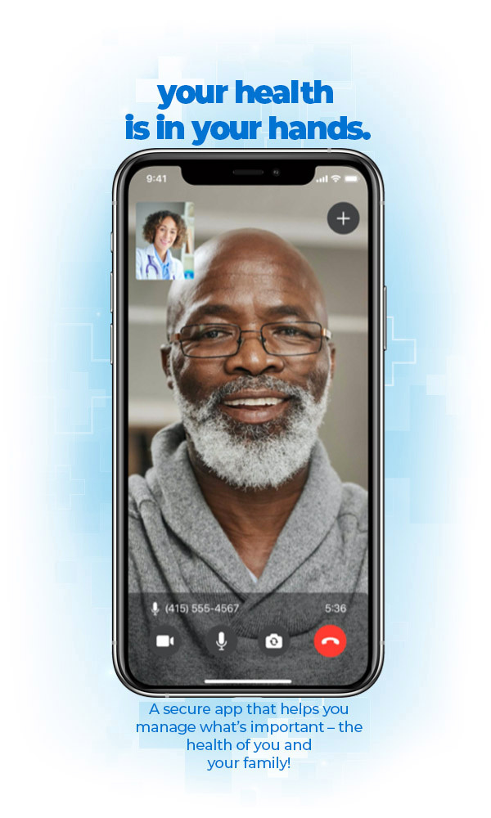
Proprietary & Confidential | This Is NOT Insurance.
14 min.
THE NETFLIX OF HEALTHCARE
Avgerage Urgent
Care Wait Time
24/7
KonnectMD has been disrupting healthcare since 2019 by delivering high-quality virtual medical care that is EASY, ACCESSIBLE, and AFFORDABLE.
KonnectMD’s member-only platform provides virtual medical services without the need for health insurance, in-person visits, copays, deductibles, claims, or prescription costs.
This is similar to how Netflix and Uber transformed their respective industries by creating a BETTER WAY!
Availability- Anywhere in the United States
Over
15,000
Medical Providers
85%
Common illnesses can be treated virtually
Only $1
per day to get started and your family is FREE
KonnectMD Virtual Healthcare
Notes:
2

Slide 4


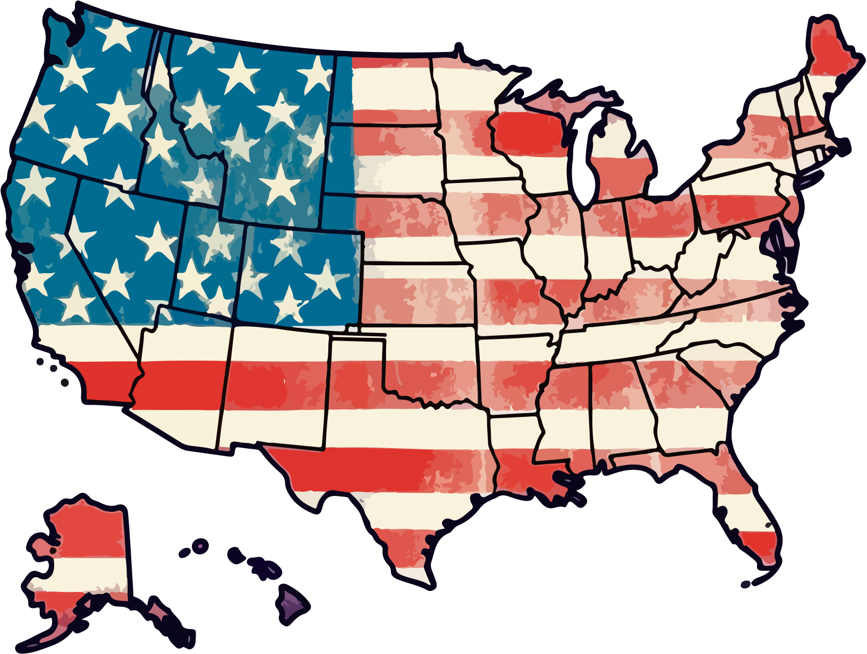





Proprietary & Confidential | This Is NOT Insurance.
Key Features
VIRTUAL URGENT CARE
  The easiest and quickest way for adults and children to request doctor’s visits on demand for minor illnesses and injuries.
  Get the care you want, when and wherever you want it —online, by phone —24/7/365.
  Save time and money! You and your family members pay $0 for unlimited visits.
  Avoid missing work or cutting your vacation short due to unnecessary trips to the ER, urgent care, or doctor's office.
Available nationwide (all 50 states)
Spanish-language portal & providers available
Prescriptions* can be picked-up same day, from any pharmacy
State licensed, board-certified medical providers
What We Treat
Allergies
Bites & Stings
Bronchitis
COVID 19
Diarrhea
Flu Symptoms
Medication Refills
Nausea
Sinus Symptoms
Skin Infections
Urinary Tract Infections
And more
Health & Wellness
KonnectMD Virtual Healthcare
*when medically necessary
Health & Wellness
Notes:
Allergies
Bites & Stings
Bronchitis
Diarrhea
Fever
Flu Symptoms
Medication Refills
Nausea
Sinus Symptoms
Skin Infections
Urinary Tract Infections
And more
11

Slide 5





Proprietary & Confidential | This Is NOT Insurance.
Key Features
VIRTUAL COUNSELING
  Immediate: (On-Demand Talk Therapy) 24/7 Access to high-quality, convenient, and confidential mental health counselors or licensed therapists.
  Schedule: (Scheduled Counseling Sessions) Our team can select and schedule a visit with a provider that matches their needs.
  Private: The visit mode can be decided based on the preferences of the healthcare provider and the patient. (video or phone).
  No Consult Fees for you or your family.
Available nationwide (all 50 states)
Get a scheduled appointment within 1 week
Members can meet with the same therapist
The average therapy visit is 40 minutes
What We Treat
Addiction
Anxiety
Depression
Divorce
Eating Disorders
Grief/Loss
Mood Swings
Panic Attacks
Performance Coaching
Relationships
Sexuality
And more
Health & Wellness
KonnectMD Virtual Healthcare
*no medications will be prescribed
Notes:
15

Slide 6



Proprietary & Confidential | This Is NOT Insurance.
Key Features
VIRTUAL PRIMARY CARE
  Select a Primary Care Physician to manage routine care, preventative care, referrals to specialists, prescription refills, etc.
  Includes specialty care and prescribed medications for needs like weight loss management, men’s health, and women’s health.
  Only $25 per appointment.
  (3) Complimentary Virtual Dermatology Consults: Access care and prescriptions for thousands of skin, hair, and nail conditions.
Available nationwide (all 50 states)
Choose a preferred provider from our network
Prescriptions* can be picked-up same day, from any pharmacy
State licensed, board-certified medical providers
What We Treat
Birth Control
Cold Sores
Diabetes
Erectile Dysfunction
Herpes
High Blood Pressure
Gout
Migraines
Sexual Health
Skin Infections
Urinary Tract Infections
And more
Health & Wellness
KonnectMD Virtual Healthcare
*when medically necessary
Health & Wellness
Notes:
Allergies
Bites & Stings
Bronchitis
Diarrhea
Fever
Flu Symptoms
Medication Refills
Nausea
Sinus Symptoms
Skin Infections
Urinary Tract Infections
And more
11

Slide 7





Proprietary & Confidential | This Is NOT Insurance.
Key Features
PRESCRIPTION PROGRAM
(All Members)
  No Cost Acute/Immediate Need Meds: Pick up the most prescribed acute medications on our formulary at NO COST. These meds treat common illnesses like colds, flu, allergies, UTIs, fever, nausea, etc.
(Platinum Members-only)
  $5 Chronic/Maintenance Need Meds: Access the top prescribed chronic meds on our formulary for only $5 per prescription. These meds treat illnesses like high blood pressure, diabetes, erectile dysfunction, etc.
Available nationwide (all 50 states)
Up to 80% off all other medications
Over 65,000 participating pharmacies
Chronic meds can be mail-ordered and delivered to your home
Partnered with Top Brands
Health & Wellness
KonnectMD Virtual Healthcare
Notes:
15

Slide 8
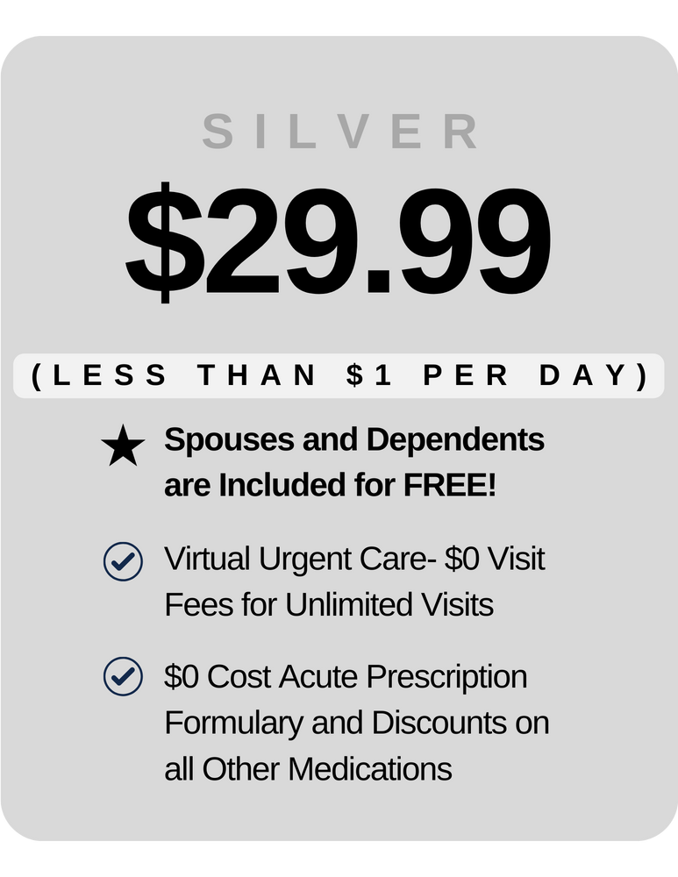

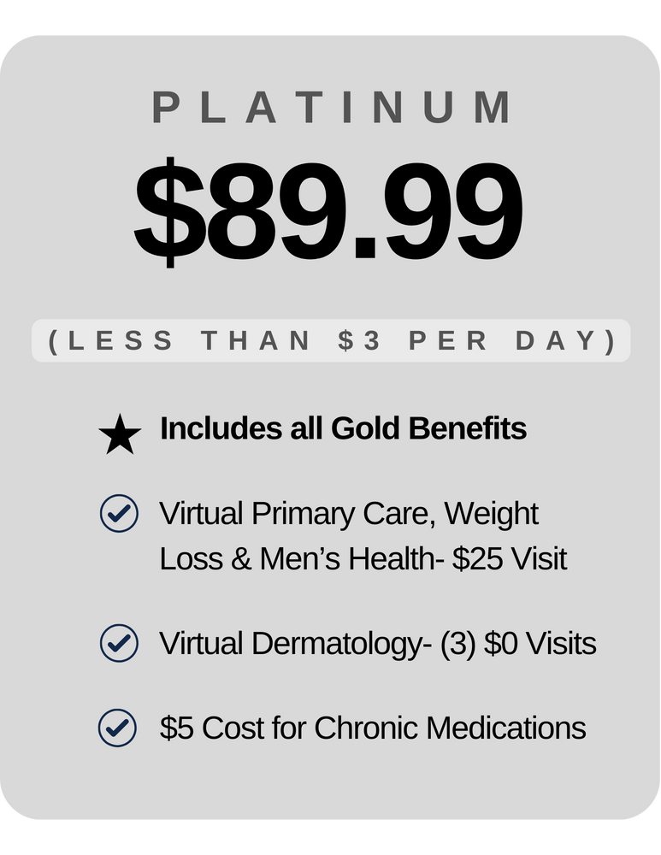




Proprietary & Confidential | This Is NOT Insurance.
BECOME A MEMBER TODAY!
Enroll for just $29.99 plus the monthly membership fee. Includes your family for FREE! Once enrolled, you’ll get immediate access.
Silver Plan
$29.99 montly
Gold Plan
$59.99 monthly
Platinum Plan
$89.99 monthly
$1 per day
$2 per day
$3 per day (most popular)
includes Silver Plan Features +
includes Gold Plan Features +
•Virtual Urgent Care
(Unlimited Visits w/$0 Fees)
•Message a Doctor for Second Opinions and Medical Advice
•PCP for Weight Loss Management, Men’s Health, etc.
•NO COST Acute Formulary Meds plus Discounts of up to 80% on other Rx drugs.
•On Demand Talk Therapy & Behavioral Health Counseling
KonnectMD Virtual Healthcare
Notes:
Kat
6

Slide 9
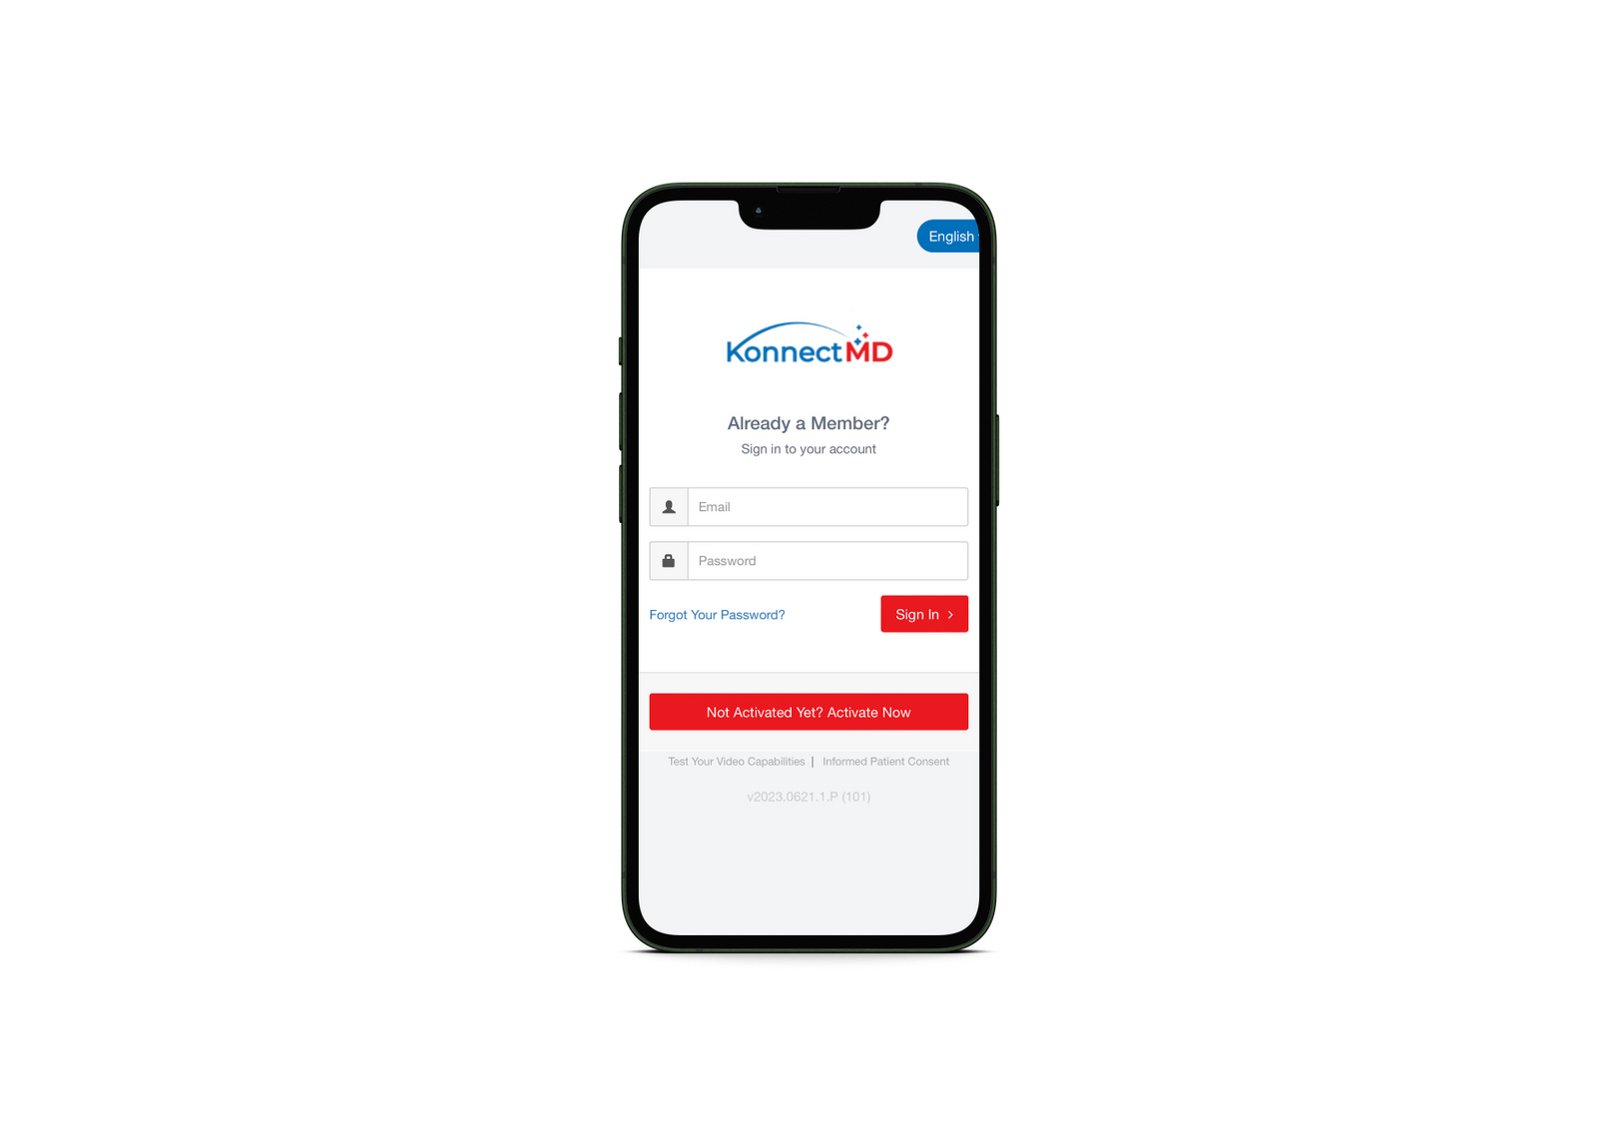
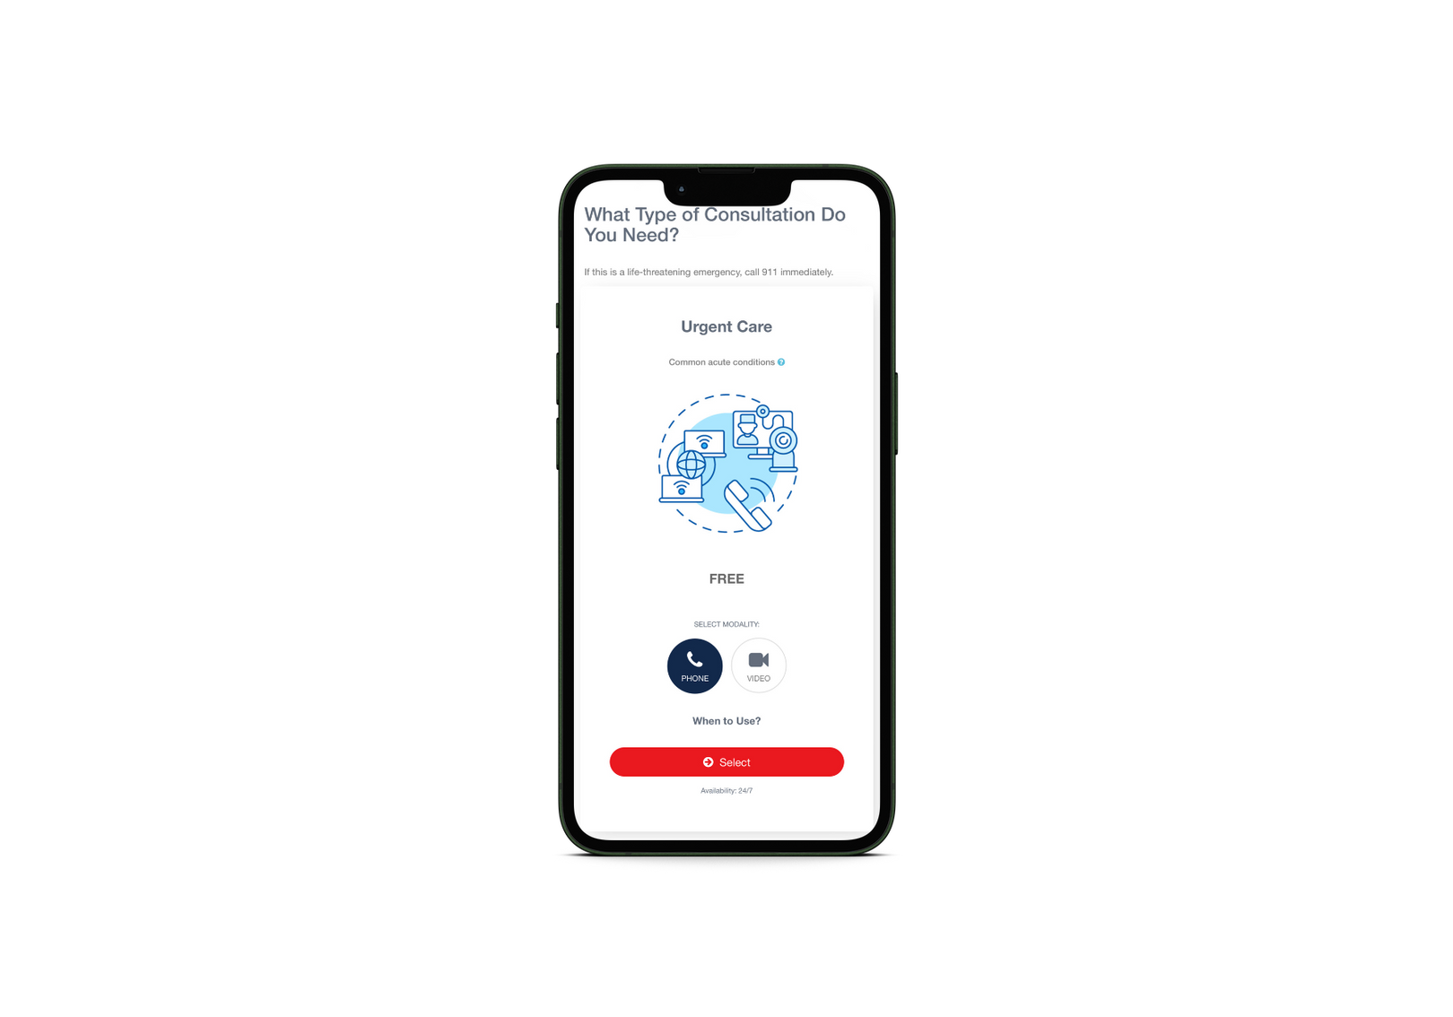
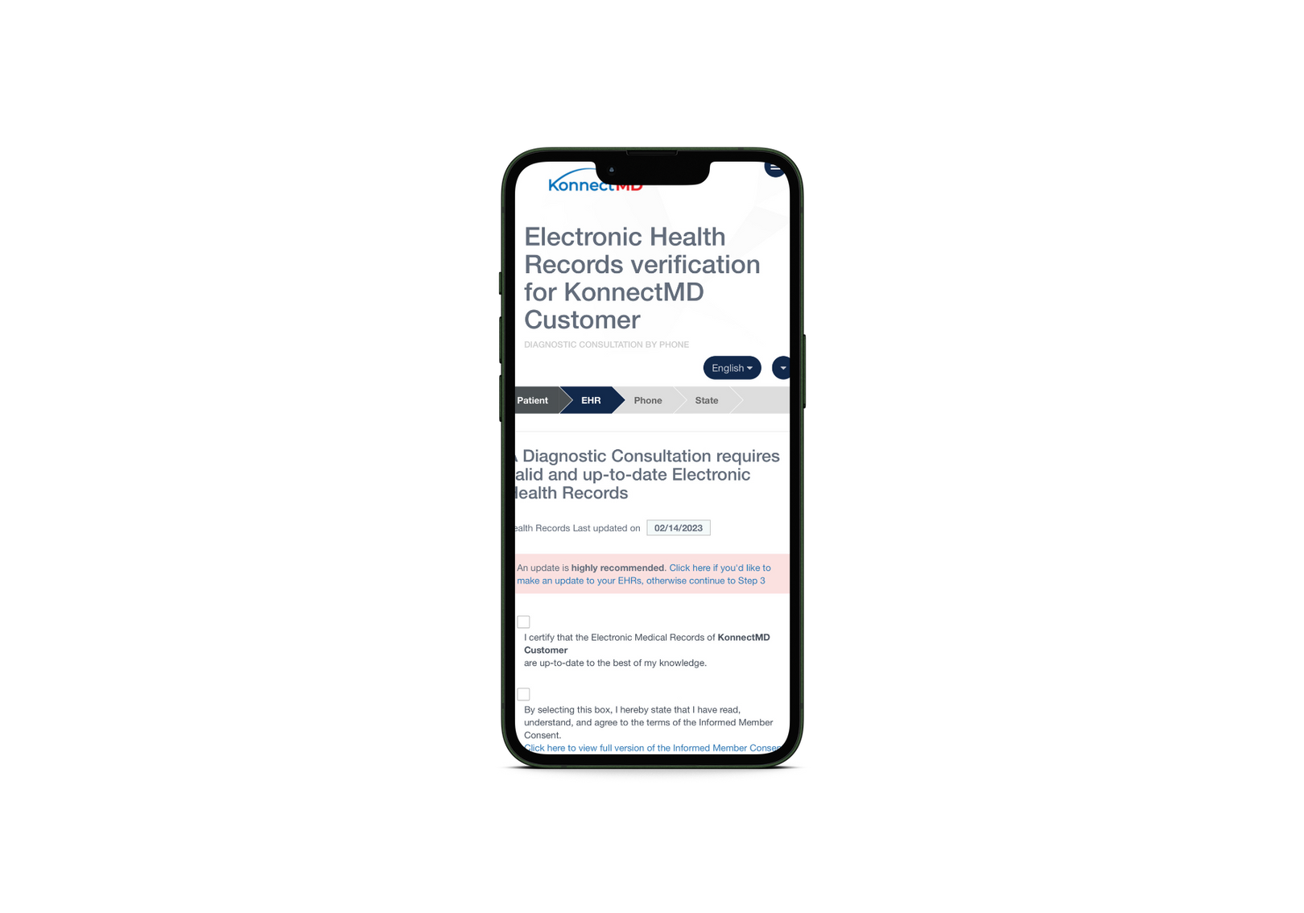
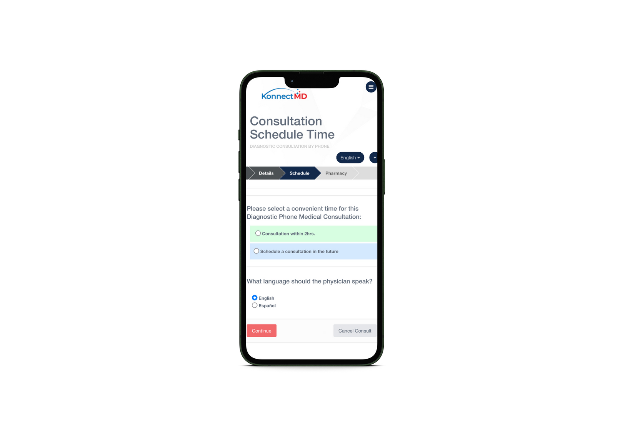

Proprietary & Confidential | This Is NOT Insurance.
HOW IT WORKS
1
Login & select patient
2
Select service type
3
Complete a brief intake & select reason for visit
4
Choose a method
5
Meet with the provider
KonnectMD Virtual Healthcare
Notes:
20

Slide 10



Making a Difference
THE FUTURE OF HEALTHCARE
“I love this service—total ease of mind.
Best telehealth provider, hands down!”
- Rachel Joy Baribeau
(Sports Broadcaster & Author)
Gold Member since 2022
“I save nearly $310 per month on meds. I can vacation with the $3700 savings!”
- Quintin Robinson
(Chief of HR @Memphis Schools))
Platinum Member since 2020
“Increased the satisfaction of my staff
and reduced our sick day requests!”
- Lisa Fausey
(CEO @Home Helpers Home Care)
Providing for Staff since 2021

Slide 11
Thanks for joining us!
We are confident that we can bring about positive change in the lives of millions struggling to access essential healthcare services.
Get Started Today!

