Slide 1



AS SEEN ON:

Slide 2






Proprietary & Confidential | This Is NOT Insurance.
IS THERE A BETTER WAY?
Due to limited access and financial barriers, many either delay seeking medical care or resort to urgent care & emergency rooms for their basic healthcare needs.
What's the Cost?
The Average Cost of an Urgent Care visit is $125 per person
Visit to the ER
Long Wait, but Open 24/7 & Flexible Billing
Did I Waste Money?
ER Visits Typically Result in a $2,200 Medical Debt
Are There Options?
Most Urgent Care Centers
Close at 6 pm
Did I Waste Time?
66% of ER Visits are
NON-EMERGENCIES
KonnectMD Virtual Healthcare
Notes:
Our Providers….
NCQA credentialing process, ensuring MeMD has a high-quality provider network, just like a hospital
Medical providers are available 24/7/365
Therapists can be seen in as few as 24 hrs.
Medical providers average 16.9 years of clinical experience
Quality assurance with 10% of charts reviewed by our Chief Medical Officer
State Licensed and U.S. board certified
Nationwide
Care Coordination…
Care Coordination team is available 24/7/365
Supports patients requesting a visit
Available to answer patient questions by phone or online chat
Streamlines intake process and on-hand to answer patient questions, troubleshoot webcam issues, etc.
3

Slide 3
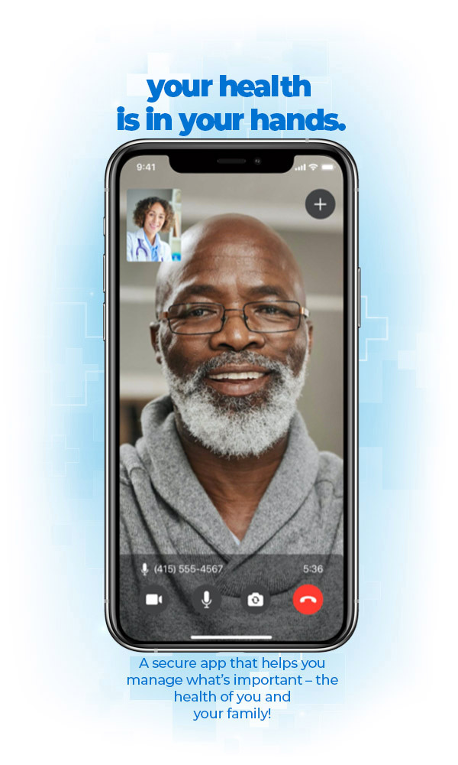
Proprietary & Confidential | This Is NOT Insurance.
14 min.
LEADING A REVOLUTION
Median
Wait Time
With KonnectMD, consumers & businesses access best-in-class virtual care whenever and wherever while increasing productivity & driving down overall healthcare costs.
We provide on-demand care services, treating nearly 85% of common illnesses and injuries that can be treated with a prescription.
KonnectMD also provides access to Behavioral Therapy & RX access to the most utilized acute & chronic medications for ZERO cost.
2019
Founded
Over
14,000
Medical Providers
First
To Market
with NO Cost Visits & NO Cost Meds
60%
of In-Person Doctor Visits & Claims Reduced
KonnectMD Virtual Healthcare
Notes:
2

Slide 4







Proprietary & Confidential | This Is NOT Insurance.
Key Features
VIRTUAL URGENT CARE
  The easy and trusted way for adults and children to request doctor’s visits on demand for minor illnesses and injuries.
  The care your employees want, when and where they want it —online, by phone —24/7/365.
  A cost-effective solution, employees and up to 7 family members pay $0 for unlimited visits
  Employees can avoid missing work due to unnecessary trips to the ER, urgent care, or doctor's office.
Available nationwide (all 50 states)
Spanish-language portal & providers available
Prescriptions* can be picked-up same day, from any pharmacy
State licensed, board-certified medical providers
What We Treat
Allergies
Bites & Stings
Bronchitis
Diarrhea
Fever
Flu Symptoms
Medication Refills
Nausea
Sinus Symptoms
Skin Infections
Urinary Tract Infections
And more
Health & Wellness
KonnectMD Virtual Healthcare
*when medically necessary
Health & Wellness
Notes:
Allergies
Bites & Stings
Bronchitis
Diarrhea
Fever
Flu Symptoms
Medication Refills
Nausea
Sinus Symptoms
Skin Infections
Urinary Tract Infections
And more
11

Slide 5





Proprietary & Confidential | This Is NOT Insurance.
Key Features
VIRTUAL COUNSELING
  Option 1: (On-Demand Talk Therapy) 24/7 Access to high-quality, convenient, and confidential mental health counselors.
  Option 2: (Scheduled Counseling Sessions) Our team can select and schedule a visit with a provider that matches their needs.
  The modality of the visit is up to the provider and patient preference (video vs. phone).
  Convenient appointments during the evenings and weekends, and most clients have an appointment within four days of requesting one.
Available nationwide (all 50 states)
Visits scheduled in as few as a few business days
Patients can meet with the same therapist
The average therapy visit is 40 minutes
What We Treat
Addiction
Anxiety
Depression
Divorce
Eating Disorders
Grief/Loss
Mood Swings
Panic Attacks
Performance Coaching
Relationships
Sexuality
And more
Health & Wellness
KonnectMD Virtual Healthcare
*no medications will be prescribed
Notes:
15

Slide 6
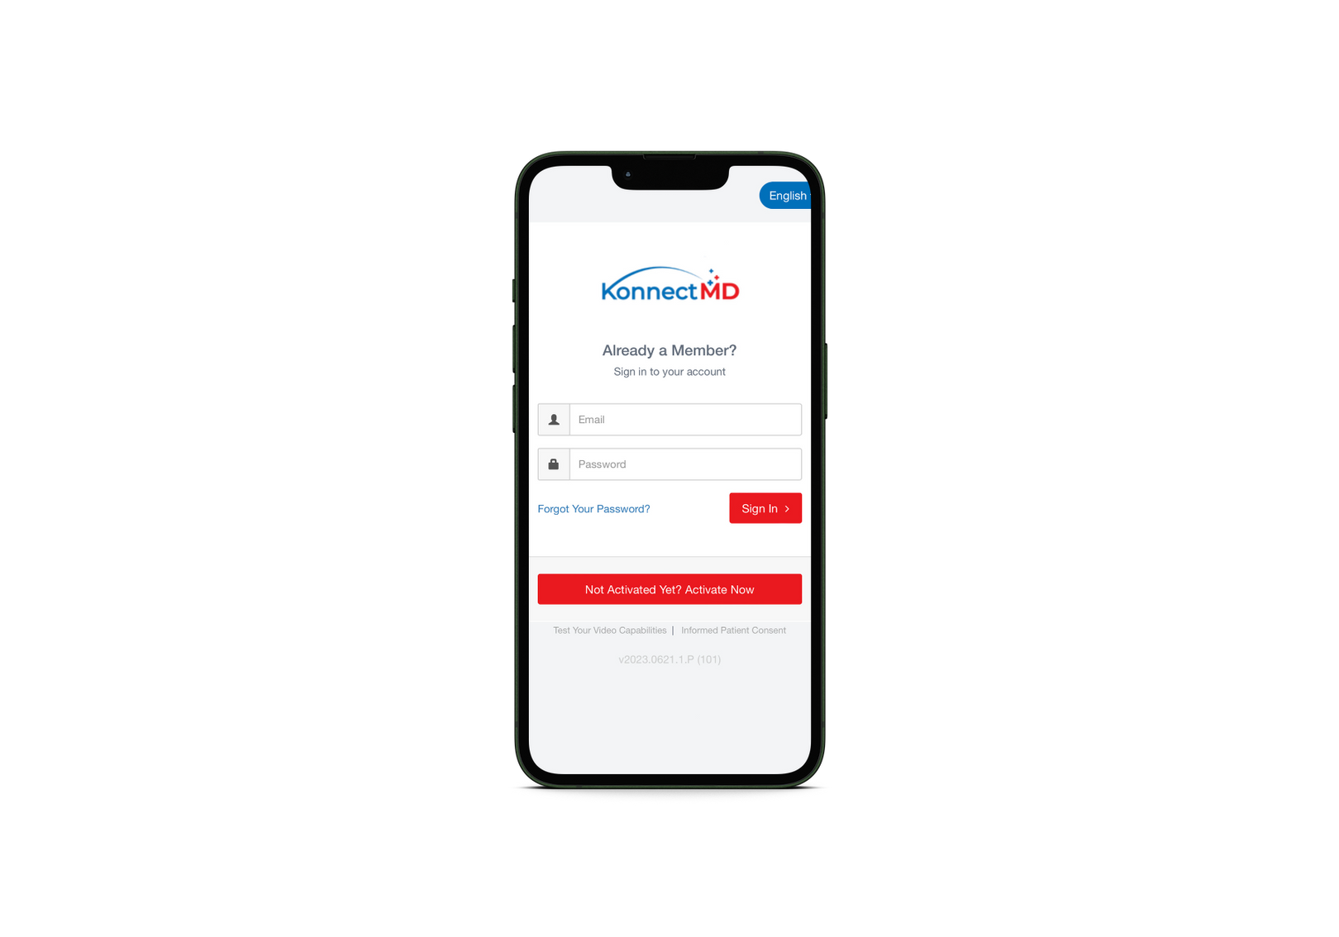
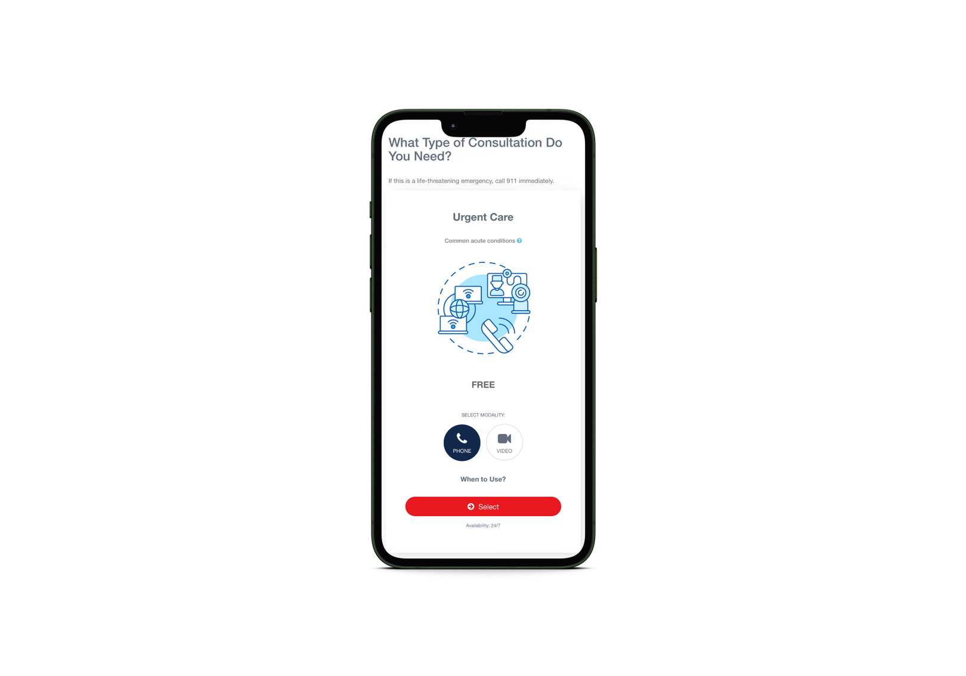
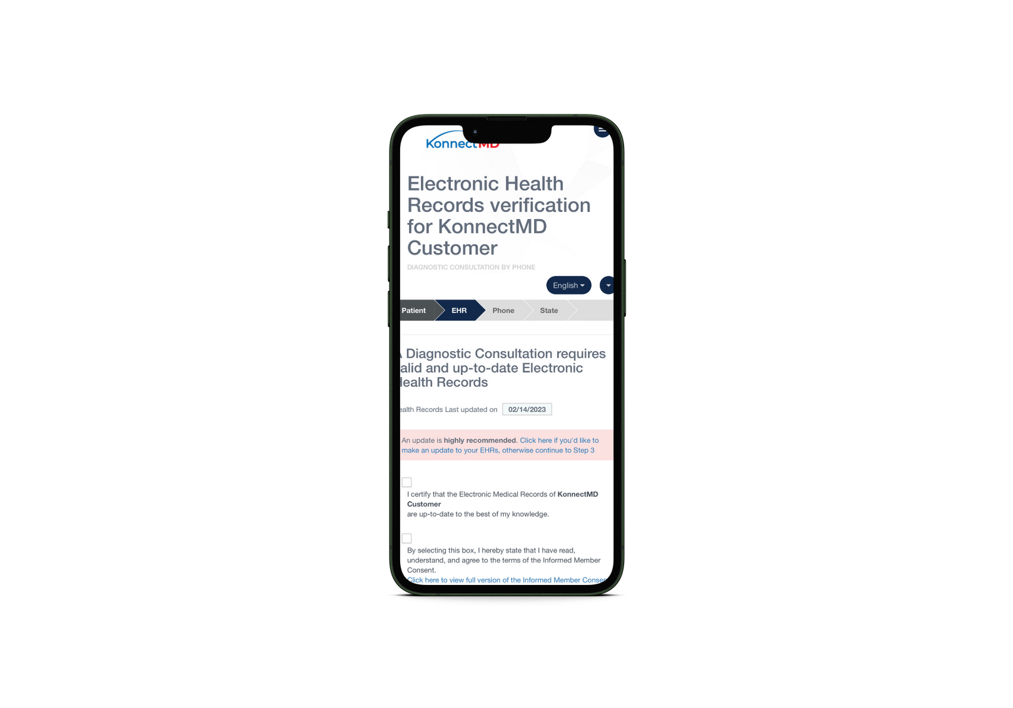
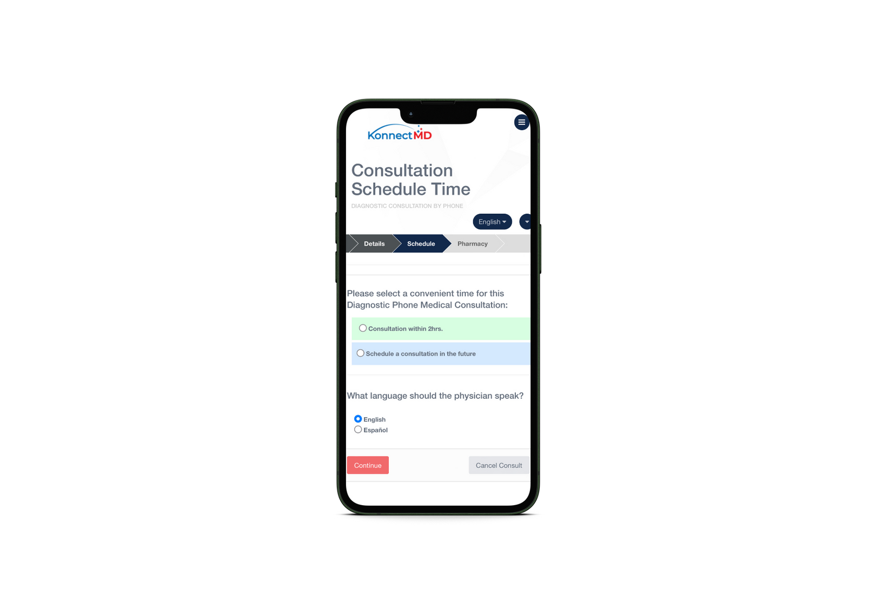

Proprietary & Confidential | This Is NOT Insurance.
HOW IT WORKS
1
Login & select patient
2
Select service type
3
Complete a brief intake & select reason for visit
4
Choose a method
5
Meet with the provider
KonnectMD Virtual Healthcare
Notes:
20

Slide 7



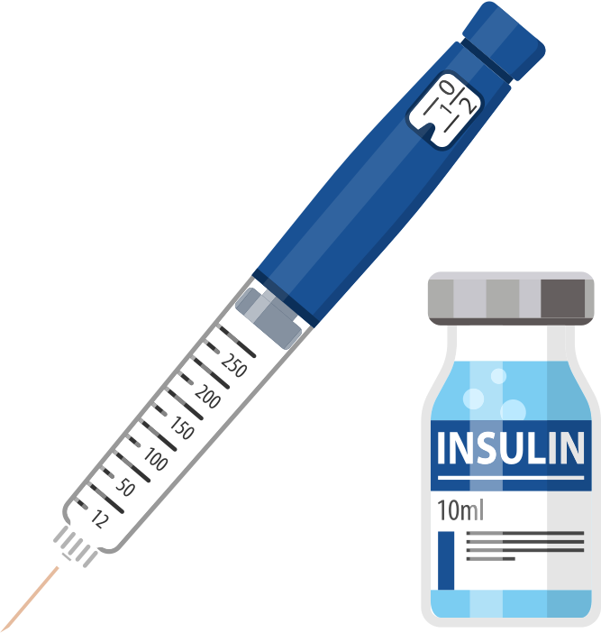


Proprietary & Confidential | This Is NOT Insurance.
Key Features
(FREE BENEFIT)
  Digital drug savings card that can be used for discounts of up to 80% on most Rx drugs.
(UPGRADED RX BENEFIT)
  Acute/Immediate Need: Pick up the top 125 most prescribed acute medications for up to a 21-day supply at NO COST.
  Chronic/Maintenance Need: Access the top 480 most prescribed chronic meds- 90-day supply, home delivered at NO COST.
Available nationwide (all 50 states)
Lowest priced insulin at $19.88 per vial
Patients can pickup acute meds from any pharmacy
Chronic meds are home delivered in a 90 Day Supply
Commonly Used For
Allergies
Antibiotics
Antifungals
Antihistamines
Anti-inflammatory
Antivirals
Asthma
Cardiac/Hypertension
Cholesterol
Diabetes
Men's Health
Mental Health
Muscle Relaxants
And more
Health & Wellness
KonnectMD Virtual Healthcare
Notes:
15

Slide 8
Proprietary & Confidential | This Is NOT Insurance.
Members Can Access These Top Meds +600 More for $0 Cost!
  ACYCLOVIR
  ALLOPURINOL
  AMITRITYLINE
  AMLODIPINE
  AMOXICILLIN
  ANASTRAZOLE
  ATENOLOL
  ATORVASTATIN
  AZITHROMYCIN
  AMLODIPINE
  BUPROPION
  CARVEDILOL
  CEFDINIR
  CELECOXIB
  CEPHALEXIN
  CIPROFLOXACIN
  CITALOPRAM
  CLOPIDOGREL
  CYCLOBENZAPRINE
  DICLOFENAC
  DILTIAZEM
  DOXYCYCLINE
  DULOXETINE
  ESCITALOPRAM
  ESTRADIOL
  EZETIMIBE
  FENOFIBRATE
  FINASTERIDE
  FLUCONAZOLE
  FLUOXETINE
  GLIMEPIRIDE
  GLIPIZIDE
  HYDRALAZINE
  IBUPROFEN
  LAMOTRIGINE
  LEVOTHYROXINE
  LIOTHYRONINE
  LISINOPRIL
  LISINOPRIL/HCTZ
  LOSARTAN
  MELOXICAM
  METFORMIN
  METHOTREXATE
  METOPROLOL
  MONTELUKAST
  OMEPRAZOLE
  PANTOPRAZOLE
  PAROXETINE
  PRAVASTATIN
  PROGESTERONE
  ROSUVASTATIN
  SERTRALINE
  SIMVASTATIN
  SILDENAFIL
  TAMSULOSIN
  TRAMADOL
  TRAZODONE
  TRIAMCINOLONE
  VALACYCLOVIR
  VENLAFAXINE
View & Download Our Full List On Our Website
KonnectMD Virtual Healthcare

Slide 9




Proprietary & Confidential | This Is NOT Insurance.
Increase Retention- Businesses that offer effective benefits have higher employee satisfaction and retention rates.
Provider Team
Your Employees Are Counting On You
KonnectMD helps your business by addressing the most prevalent pain points your population faces regarding their healthcare:
Cost, Access, and Overly Complicated Patient Experiences.
Providing KonnectMD benefits your business too!
Attract Talent- Businesses that offer exceptional benefits stand out, become the top choice for job seekers, and hire 60% faster.
Reduce Sick Days- Access to a "Virtual First" Approach allows employees to seek care on-demand, reducing the need for time off.
Lower Healthcare Costs- Lower claims and reduce premiums by minimizing visits to urgent care, doctor’s offices, and the ER.
For a happier, healthier, productive and present workforce.
Health & Wellness
KonnectMD Virtual Healthcare
Notes:
22

Slide 10






Proprietary & Confidential | This Is NOT Insurance.
EVERYBODY WINS HERE
Plans can be employer or employee paid. Each plan covers the employee + up to 7 family members. You can add/remove employees anytime.
Silver Plan
$14.99 pepm
Gold Plan
$29.99 pepm
Platinum Plan
$49.99 pepm
.50 per day
$1 per day (Most Popular)
Less than $1.67 per day
includes Silver Plan Features +
includes Gold Plan Features +
•Virtual Urgent Care
(Unlimited Visits w/$0 Fees)
•No Cost Acute/Immediate
Need Medications
•On Demand Talk Therapy & Behavioral Health Counseling
•Digital drug savings card that can be used for discounts of up to 80% on most Rx drugs.
•No Cost Chronic/Maintenance Need Medications
•Discounts for Vision, Dental, Labs, Chiropractic, Diabetic & Home Medical Supplies
Good for Part Timers & 1099s
Perfect for All Employee Types
KonnectMD Virtual Healthcare
Takes Care of the Basic Needs
Notes:
Kat
6

Slide 11

AS SEEN ON:
Notes:
1

